Slide 1

Project Plan
K Anuradha
BSc (Hons) in Information Technology
MSc in Information Systems Management

Slide 2
Project Plan
A project plan is a comprehensive document that outlines the key elements of a project, including its goals, timeline, resources, risks, and strategies for execution and control.
It serves as a roadmap for the project team and stakeholders, providing a clear vision of how the project will be managed and delivered.
Notes:
Project plans set the stage for the entire project. Without one, you’re missing a critical step in the overall project management process. When you launch into a project without defined goals or objectives, it can lead to disorganized work, frustration, and even scope creep. A clear, written project management plan provides a baseline direction to all stakeholders, while also keeping everyone accountable. It confirms that you have the resources you need for the project before it actually begins.
A project plan also allows you, as the person in charge of leading execution, to forecast any potential challenges you could run into while the project is still in the planning stages. That way, you can ensure the project will be achievable—or course-correct if necessary. there is a strong correlation between project planning and project success—the better your plan, the better your outcome. So, conquering the planning phase also makes for better project efficiency and results

Slide 3
Components of Project Plan
Project overview
Detailed project schedule (Gantt chart or similar).
Resource allocation.
Budget estimation.
Risk management plan.

Slide 4

Project Overview
Project Title
Project Manager
Project Sponsor
Project Description
Notes:
Project Title: The name of the project.
Project Manager: The person responsible for managing the project.
Project Sponsor: The individual or organization providing the resources and support for the project.
Project Description: A brief summary of the project, including its purpose and objectives.

Slide 5
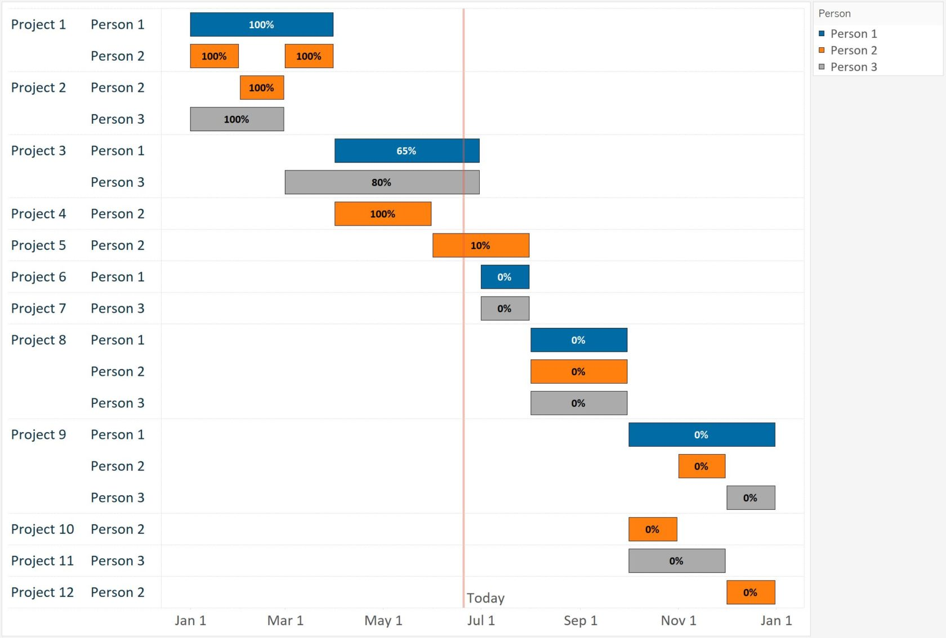
Detailed project schedule
A Gantt chart is a visual project management tool that displays the timeline of a project.
Notes:
A Gantt chart is a visual project management tool that displays the timeline of a project. It shows the start and end dates of the various tasks or activities that make up the project, as well as their relationships and dependencies. Gantt charts are useful for planning, scheduling, and tracking the progress of projects.
Key Elements of a Gantt Chart:
Tasks/Activities: Listed on the vertical axis, these are the individual tasks or activities that need to be completed.
Timeline: Displayed on the horizontal axis, this represents the duration of the project, broken down into days, weeks, or months.
Bars: Horizontal bars represent the duration of each task. The length of the bar corresponds to the task's start and end dates.
Dependencies: Arrows or lines that show the relationships between tasks, indicating which tasks must be completed before others can start.
Milestones: Special symbols (often diamonds) that mark significant events or completion points in the project.

Slide 6
Resource allocation.
Team Members: The individuals or teams involved in the project, along with their roles and responsibilities.
Resource Allocation: The distribution of resources (e.g., personnel, equipment, budget) to various project tasks.

Slide 7
Budget estimation
Cost Estimates: Detailed estimates of the financial resources required for the project.
Budget Breakdown: A breakdown of costs by category or project phase.

Slide 8
Risk management plan
Risk Identification: A list of potential risks that could impact the project.
Risk Analysis: An assessment of the likelihood and impact of each risk.
Risk Mitigation Strategies: Plans for minimizing or managing risks.

